Slide 1


Sequence Quality Assessment

Slide 2
K-mer Analysis
What is a k-mer?
A k-mer is a sequence of nucleotides of length k.
Examples of a 6-mer
ACGTCT
TGACTA
GATCCC
A read of length L has L-k+1 k-mers.
1 read:
100 bp
Kmers:
k=21bp
N= (L – k + 1)
(100bp – 21 bp + 1)
80
……..

Slide 3
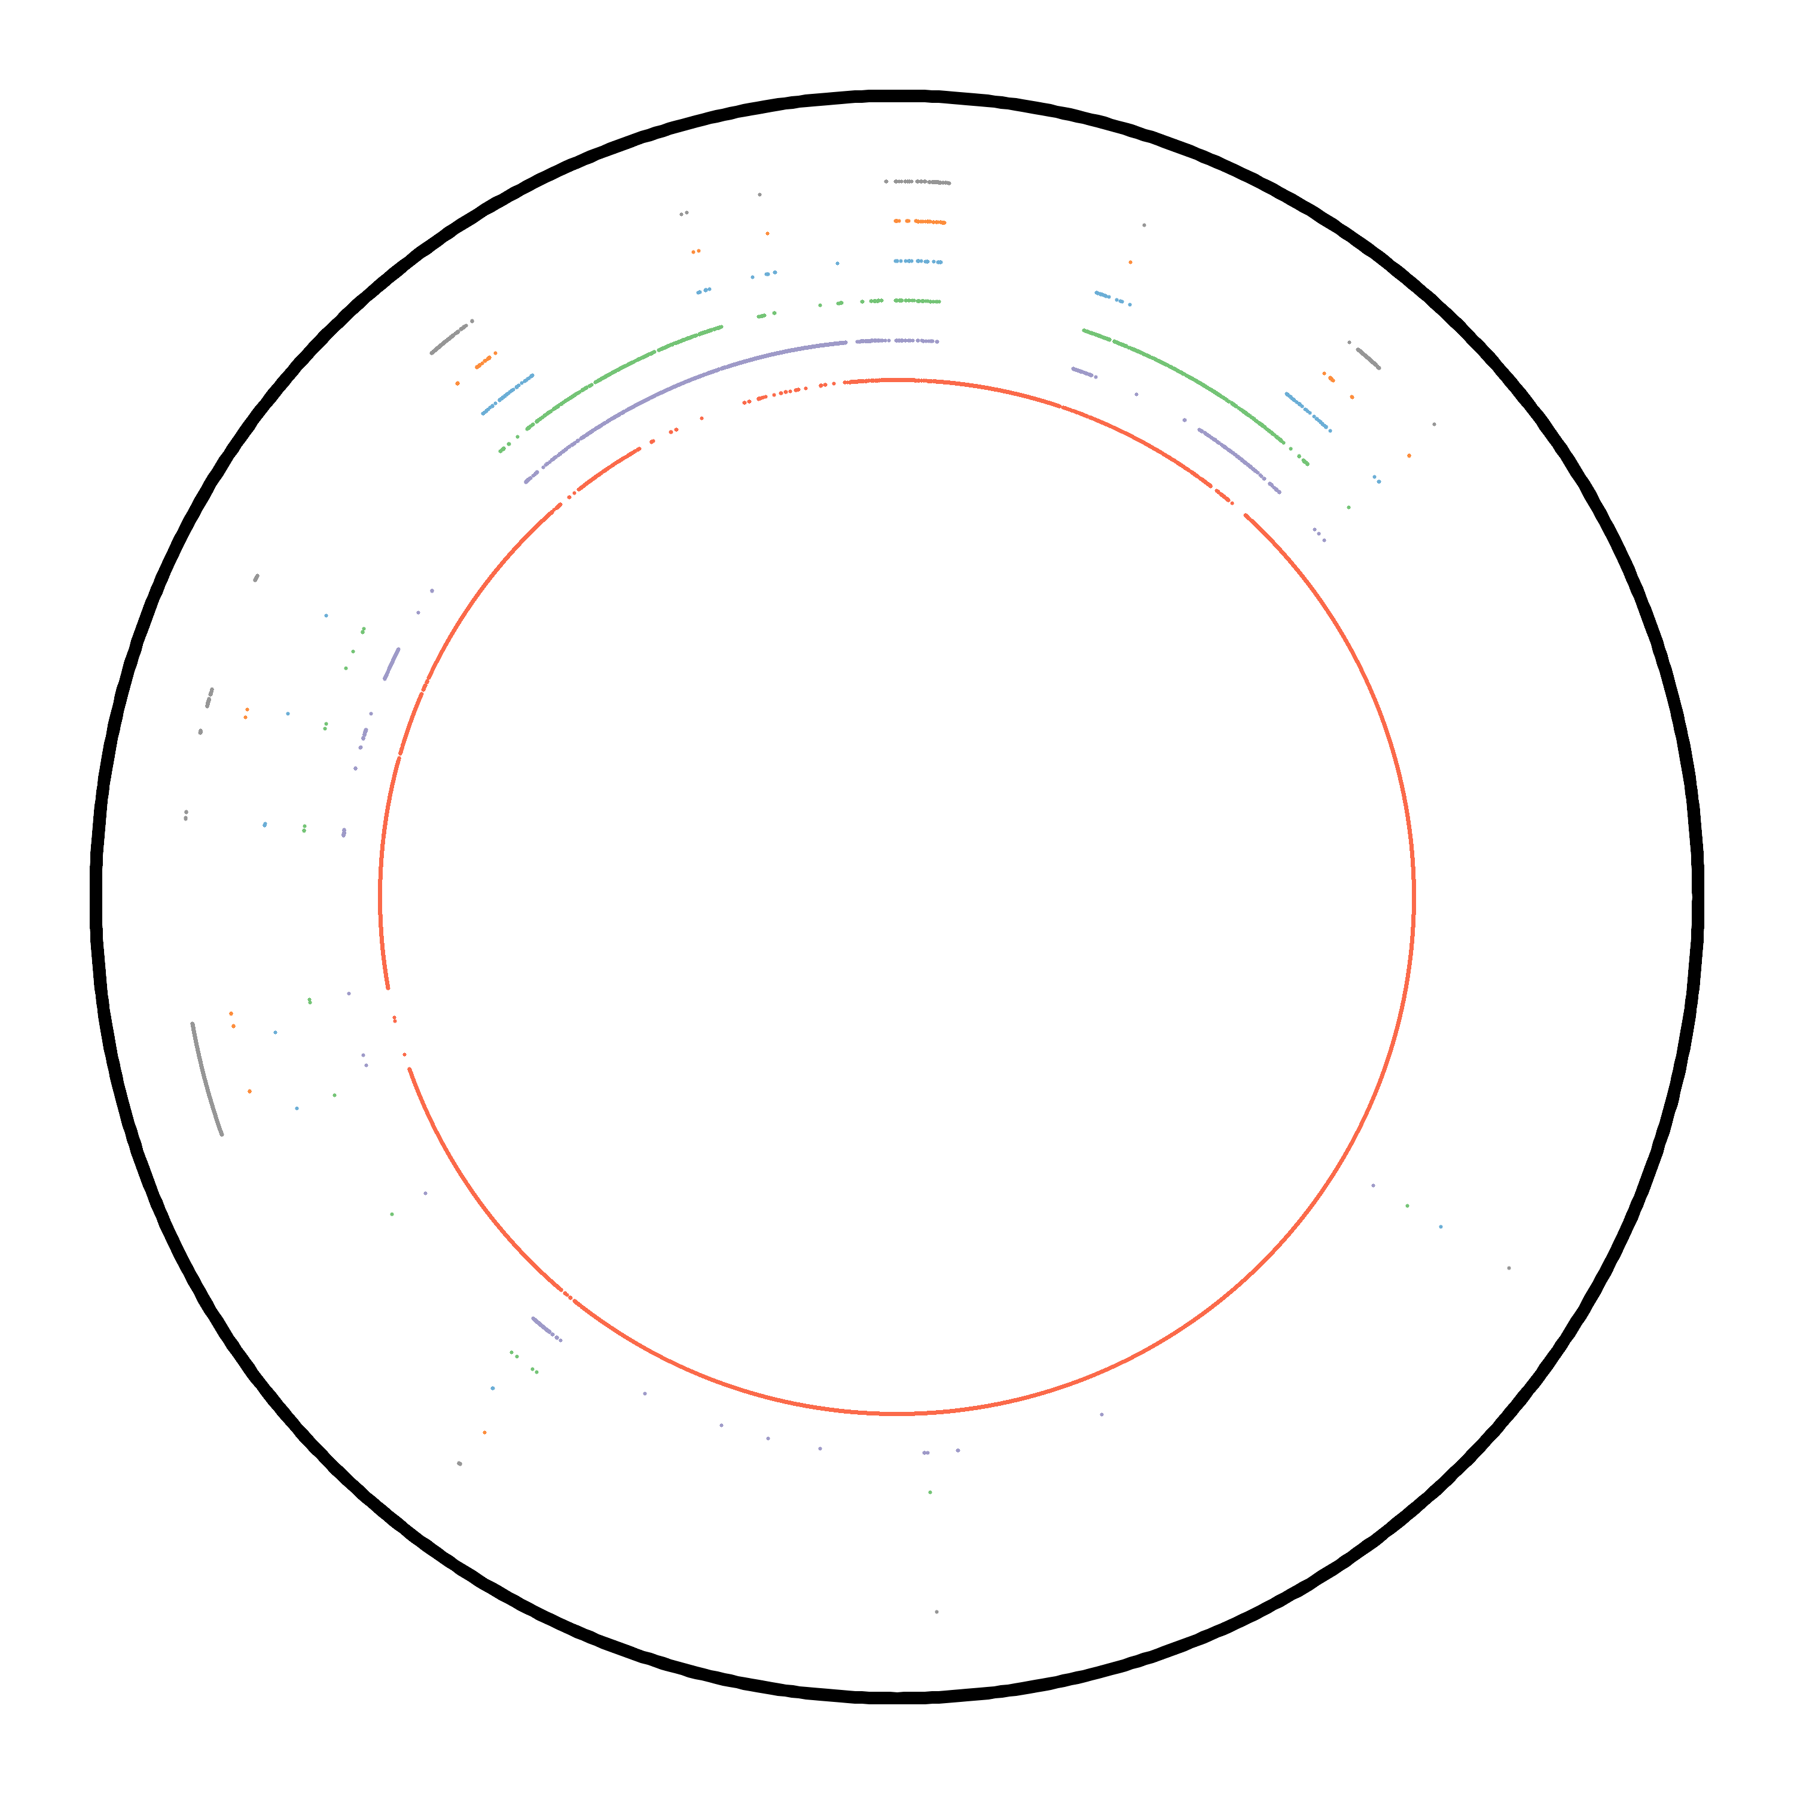
K-mer Analysis
How many k-mers are distinct in your genome?
Chr 1 of yeast strain s288c
Haploid
Linear, but plotted as circle
Black: position along chromosome
K-mer frequency in genome
K=27
Red: 1
Purple: 2
Green: 3
Blue: 4
Orange: 5
Grey: 6+
Majority of k-mers are distinct.

Slide 4
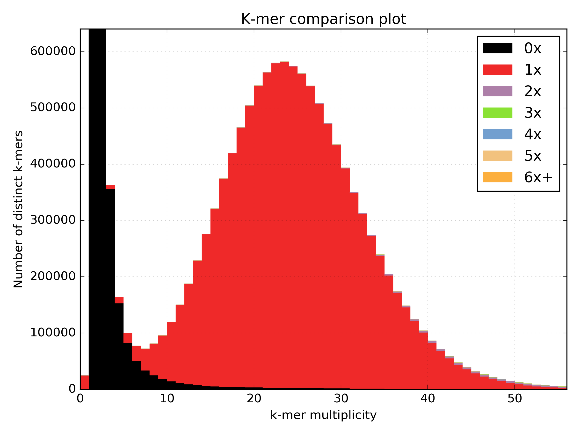
K-mer Analysis
Frequency in the genome Haploid
Frequency of those k-mers in the sequence data set
x-axis: Frequency of the distinct k-mer in the data y-axis: Count of distinct k-mers with frequency x

Slide 5
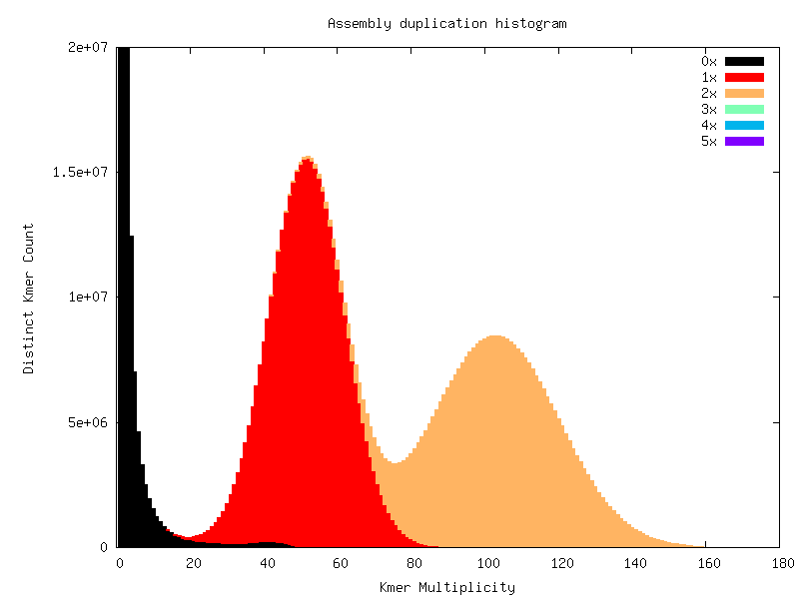
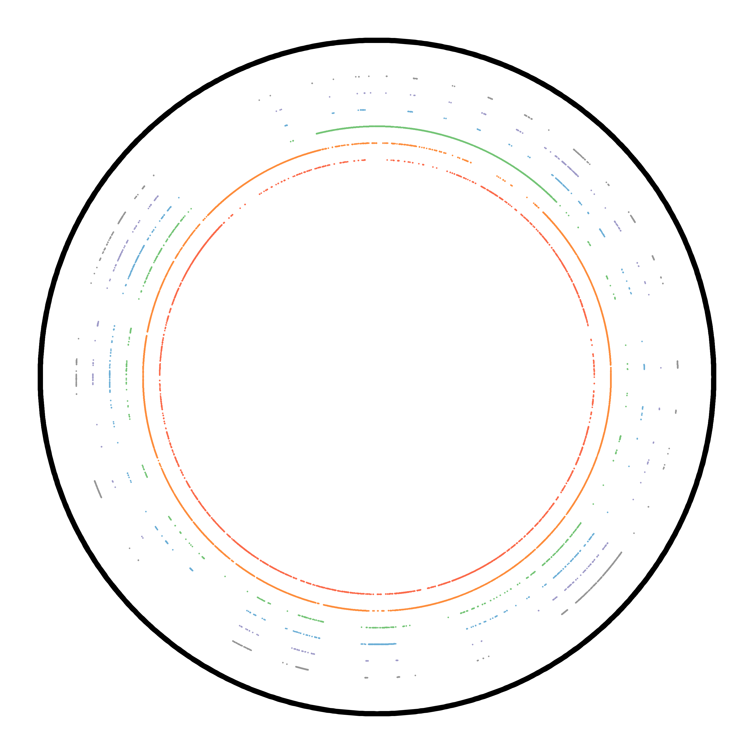
K-mer Analysis
Frequency in the genome Diploid
Frequency of those k-mers in the sequence data set
x-axis: Frequency of the distinct k-mer in the data y-axis: Count of distinct k-mers with frequency x
Contig from A.thaliana phased genome

Slide 6
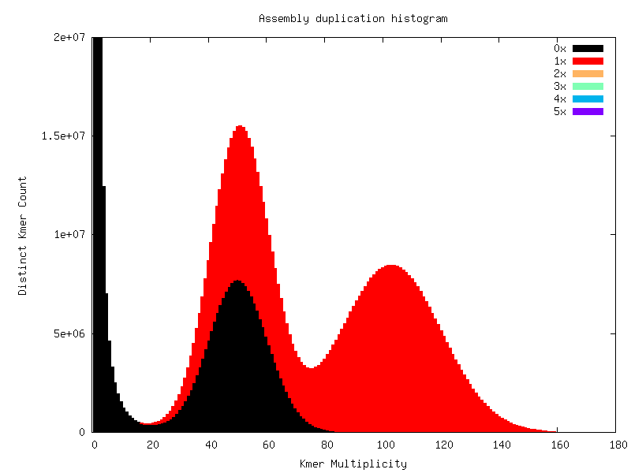
K-mer Analysis
Frequency in the genome Diploid
Frequency of those k-mers in the sequence data set
x-axis: Frequency of the distinct k-mer in the data y-axis: Count of distinct k-mers with frequency x

Slide 7
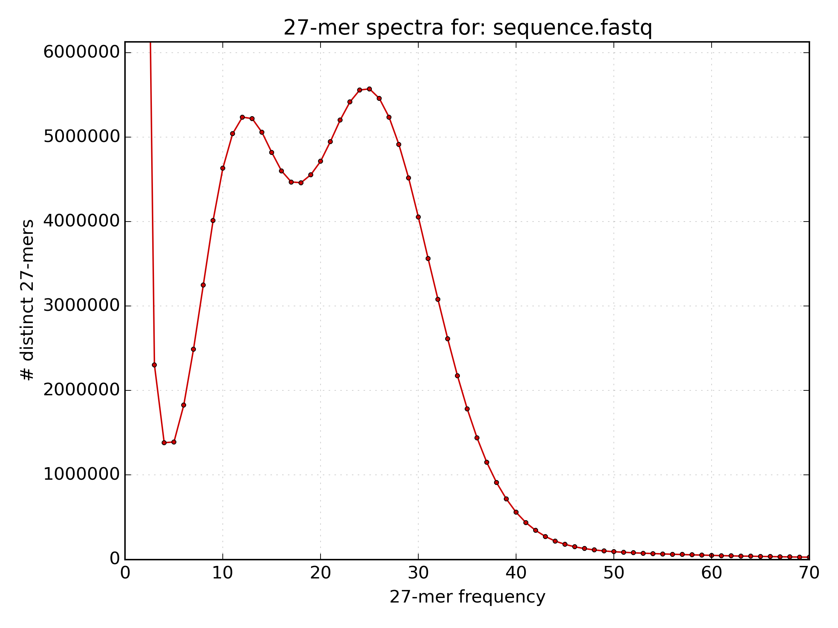
Estimating Genome Size
We can use coverage to estimate genome size
The peak with the largest k-mer multiplicity is the mean k-mer coverage across the genome.
N = M * L / (L - K + 1)
N is Depth of Read Coverage
M is mean k-mer coverage
L is read length
K is k-mer size
G = T / N
G is the genome size
T is the total number of bases

Slide 8
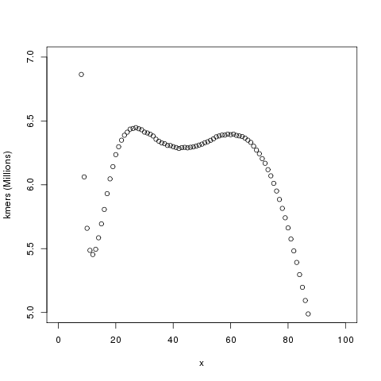
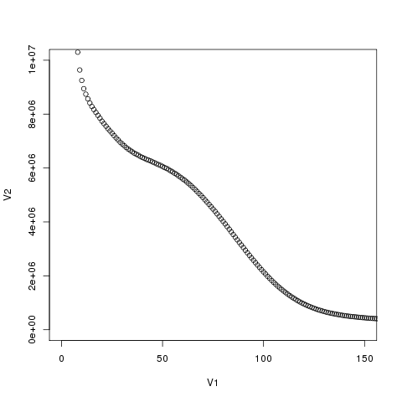
Estimating Genome Size
Not so easy: estimating complexity

Slide 9
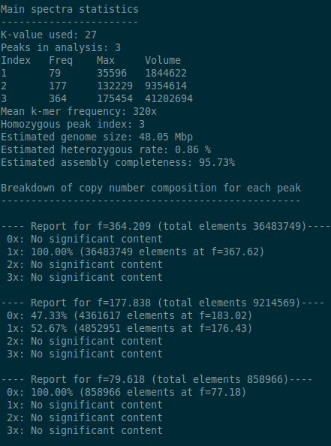
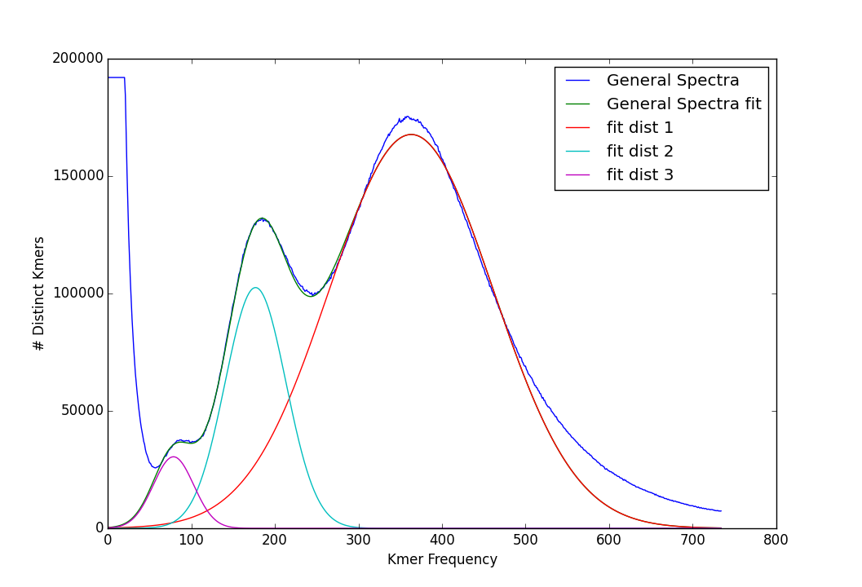
Estimating Genome Size
Distribution decomposition analysis
kat_distanalysis.py --plot kat.hist
4x
2x
x
x
Repeats
Tetraploid genome copy number spectra

Slide 10
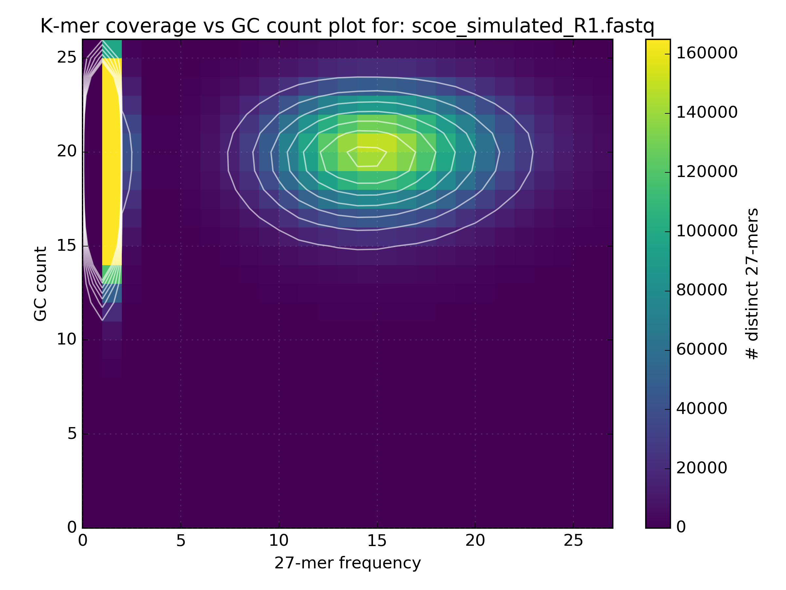
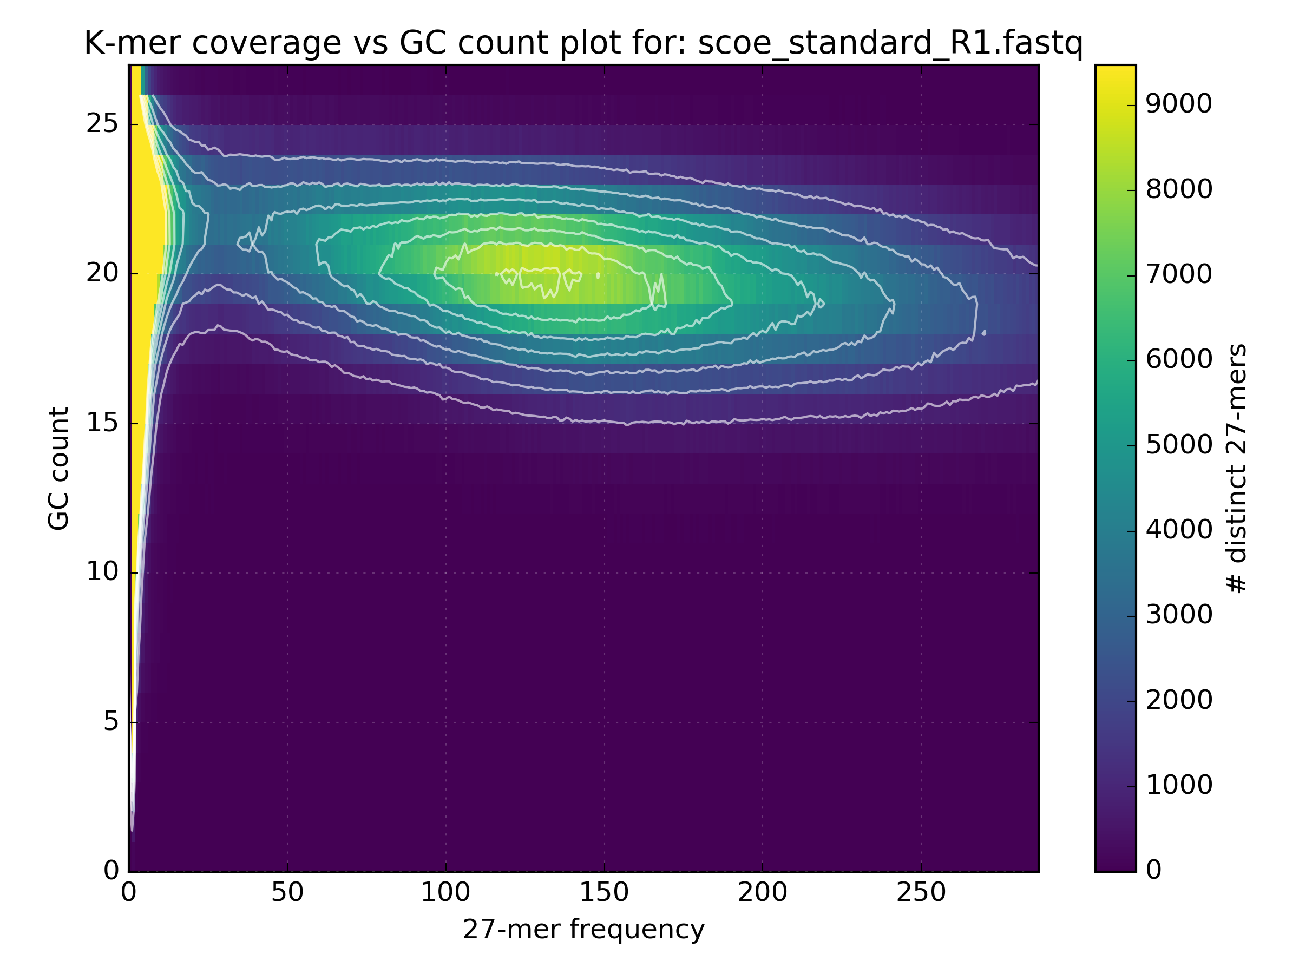
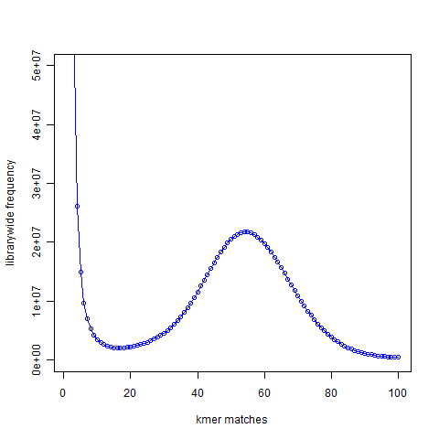
GC Content in depth
Monitor GC Bias
Simulated data
GC bias in Standard Illumina protocol
ACTCAGGATTA GC=4 Count=1
AATAGCCGGGG GC=7 Count=2

Slide 11
GC Content in depth
Monitor GC Bias
Simulated data
GC bias in Standard Illumina protocol
ACTCAGGATTA GC=4 Count=1
AATAGCCGGGG GC=7 Count=2

Slide 12
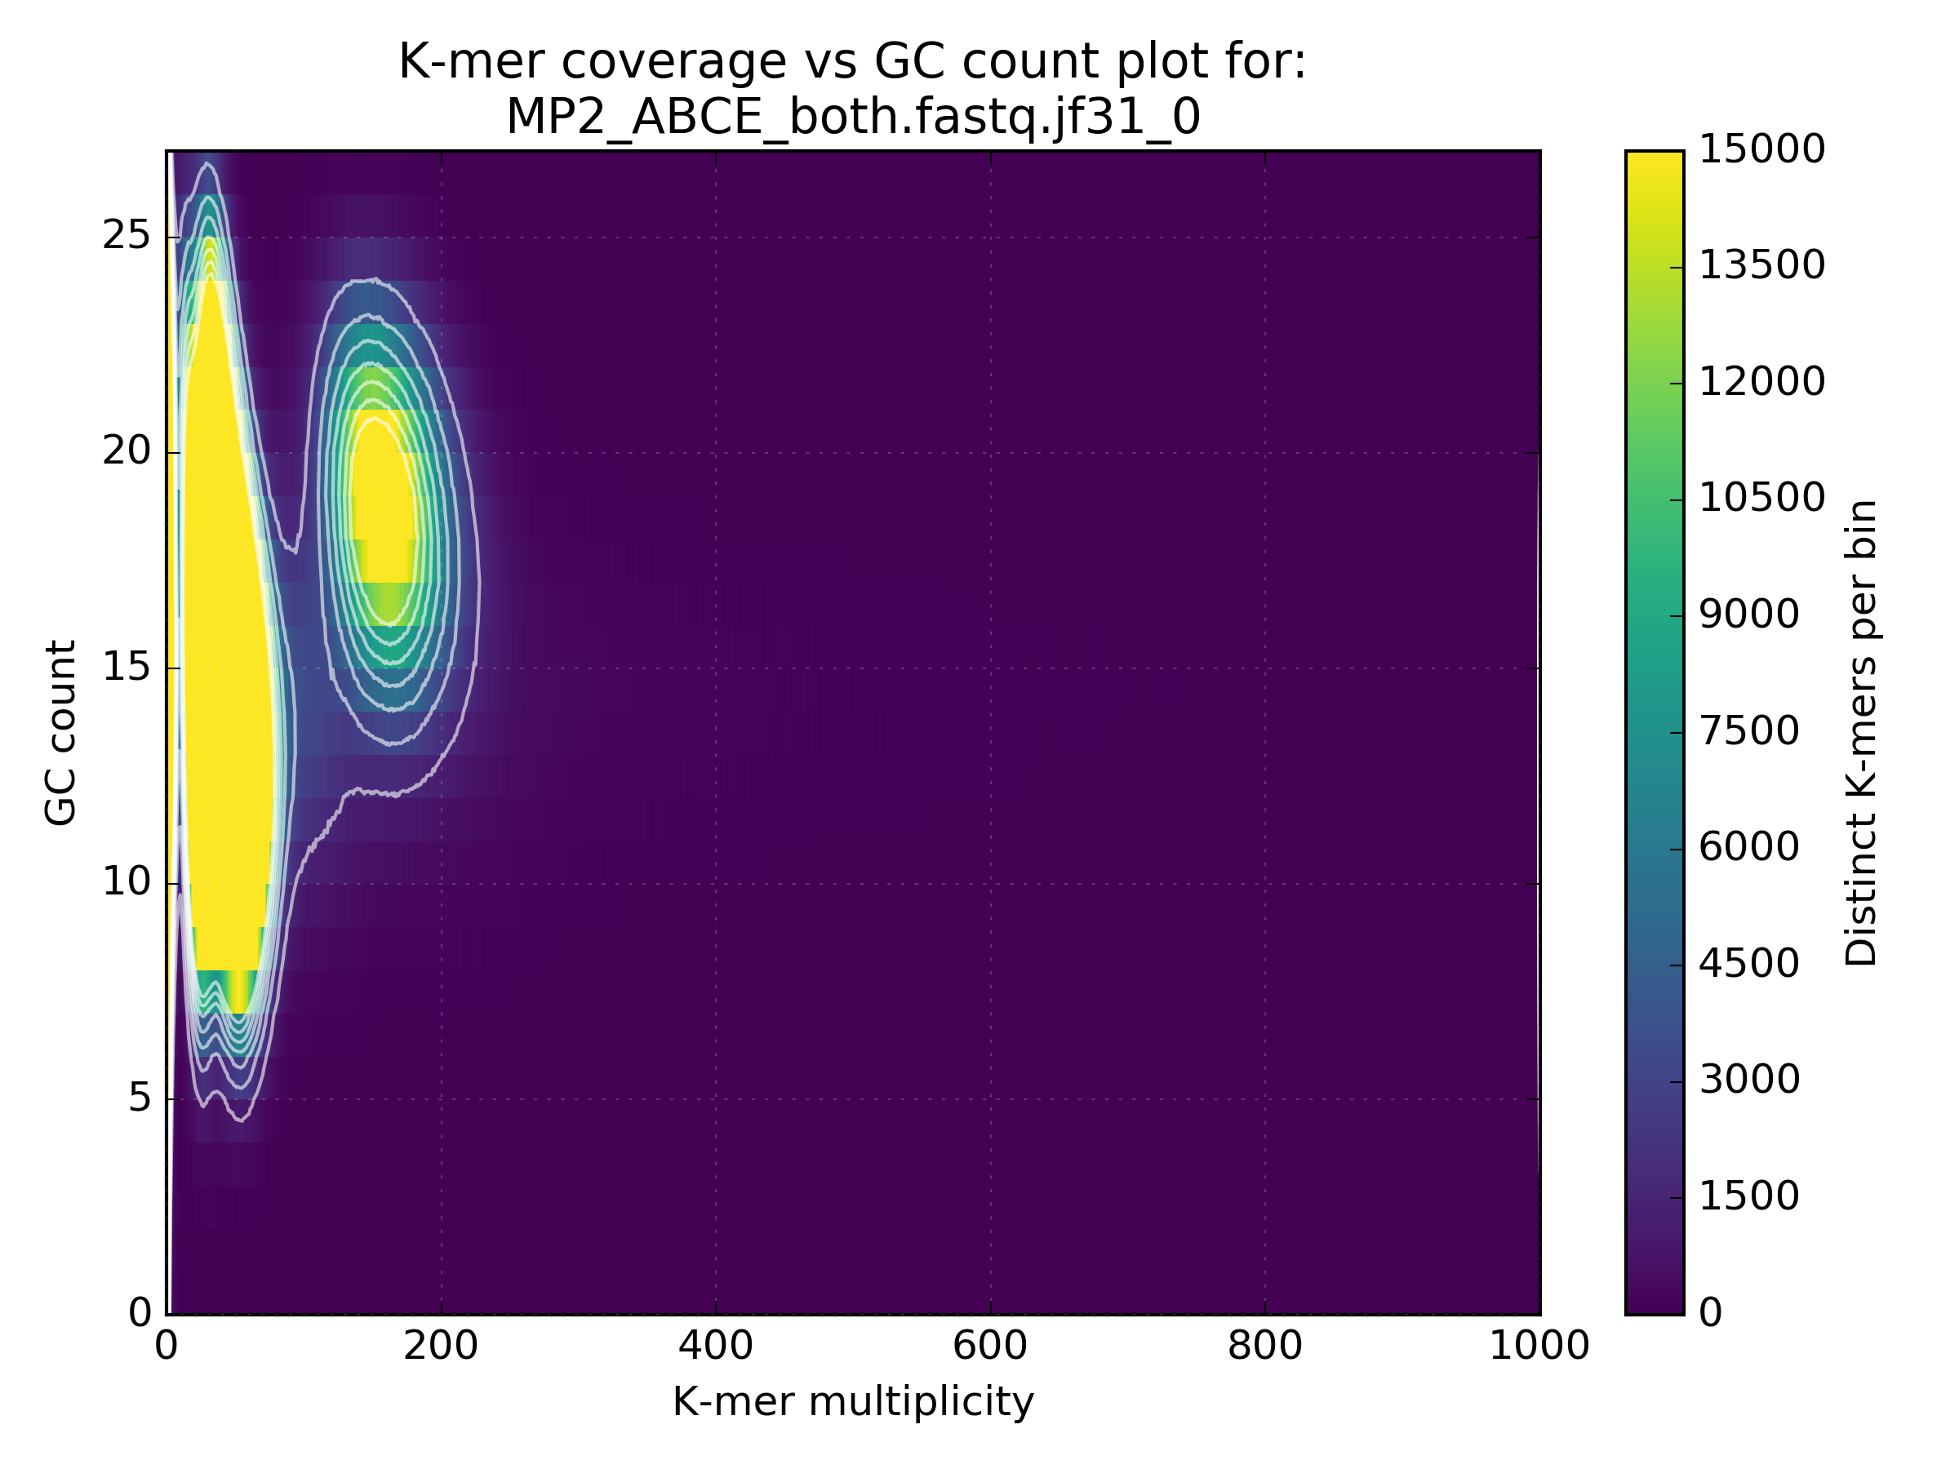
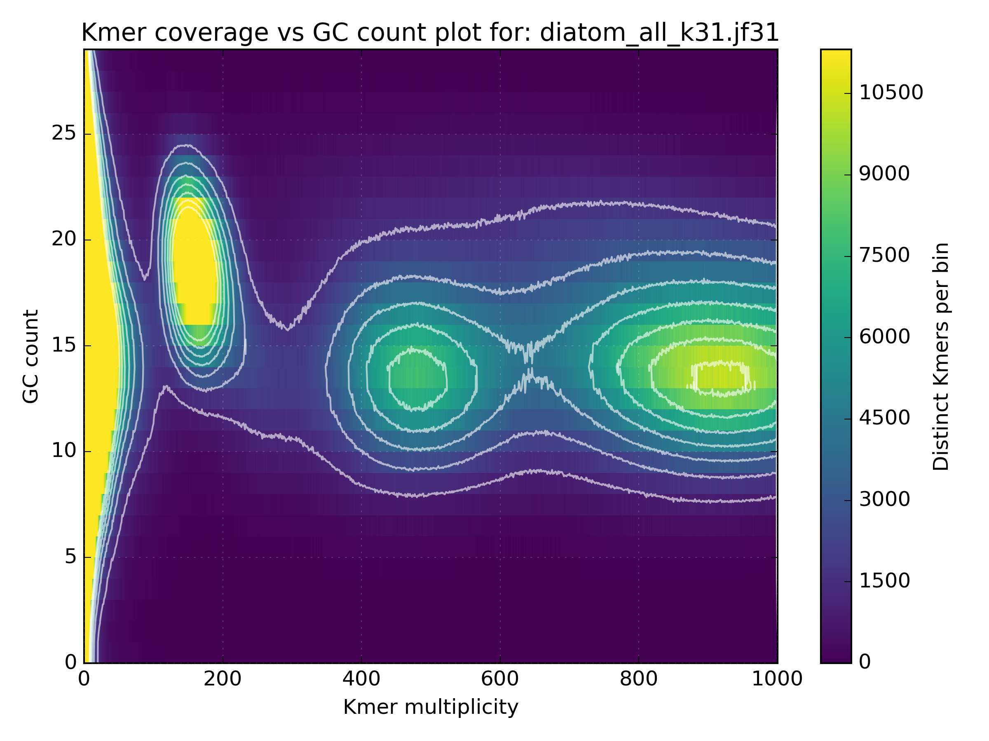
GC Content in depth
Uncover contamination
Separate bacteria from eukaryote
Separate organelle from nuclear genome

Slide 13
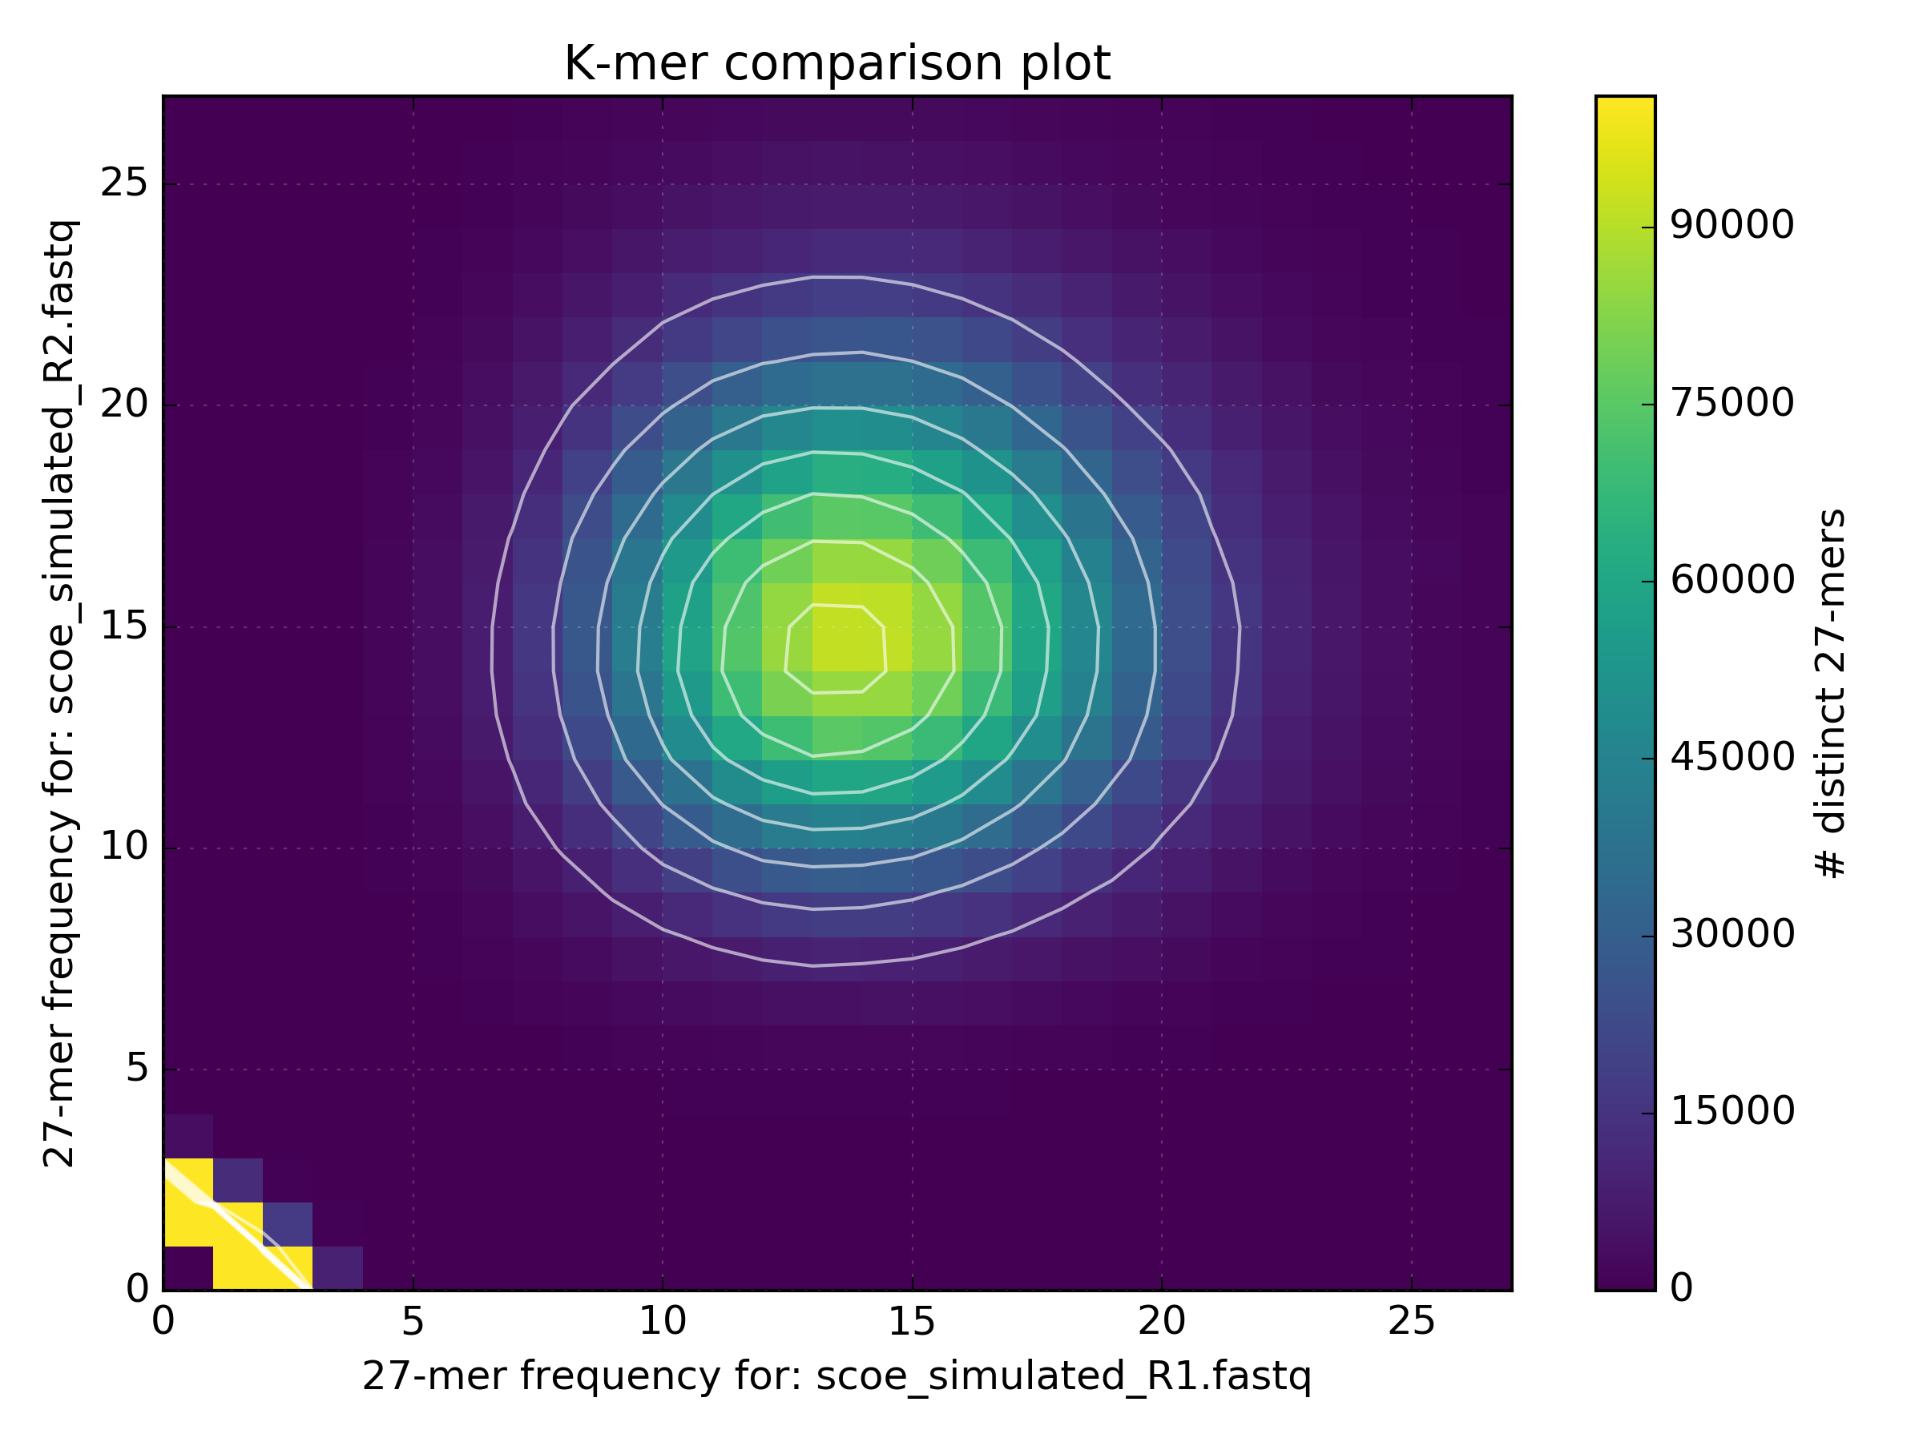
What can k-mers tell us?
Comparing k-mer counts between data reveals biases
R1 vs R2
Lib1 vs Lib2

Slide 14
What can k-mers tell us?
Comparing k-mer counts between data reveals biases
R1 vs R2
Lib1 vs Lib2

Slide 15
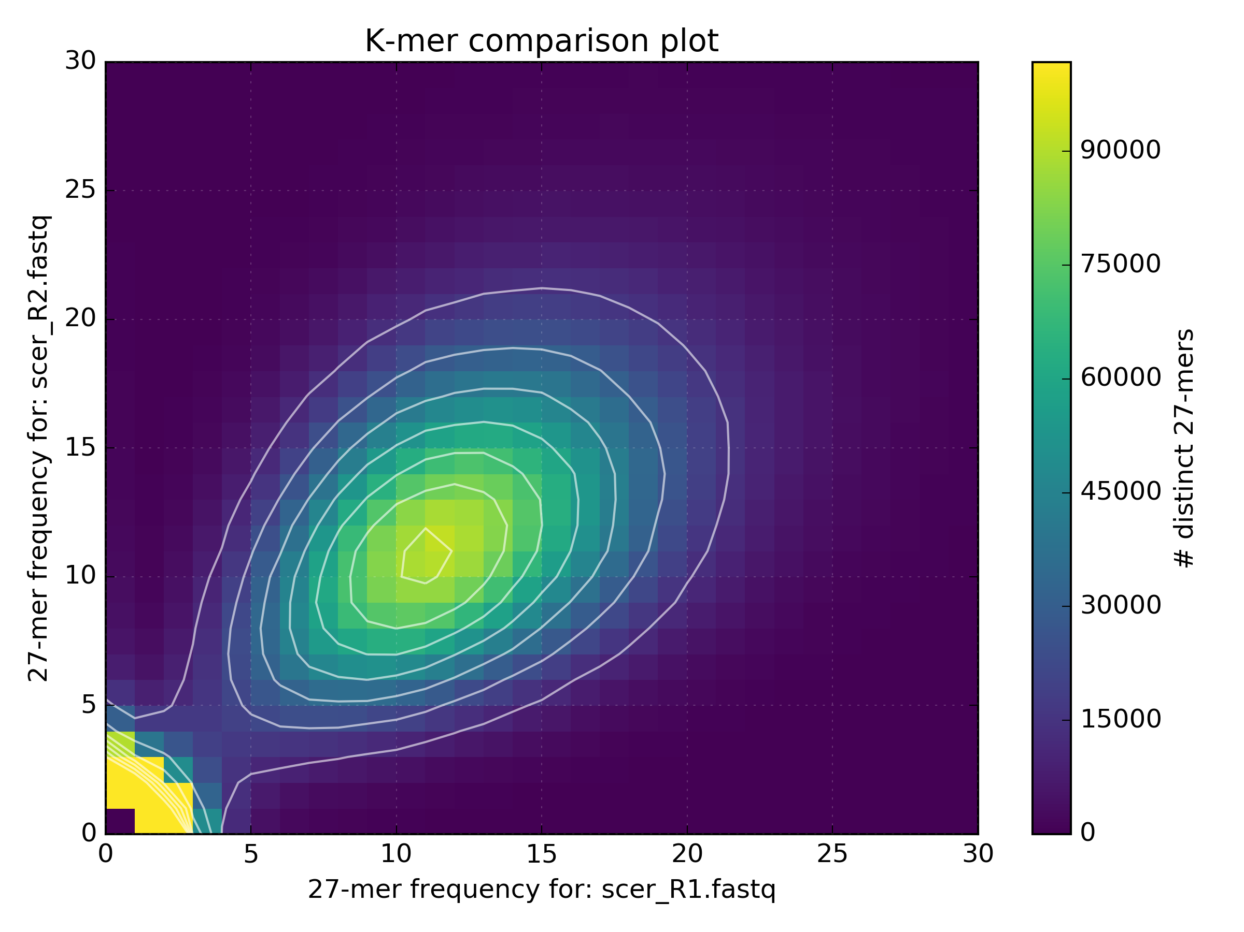
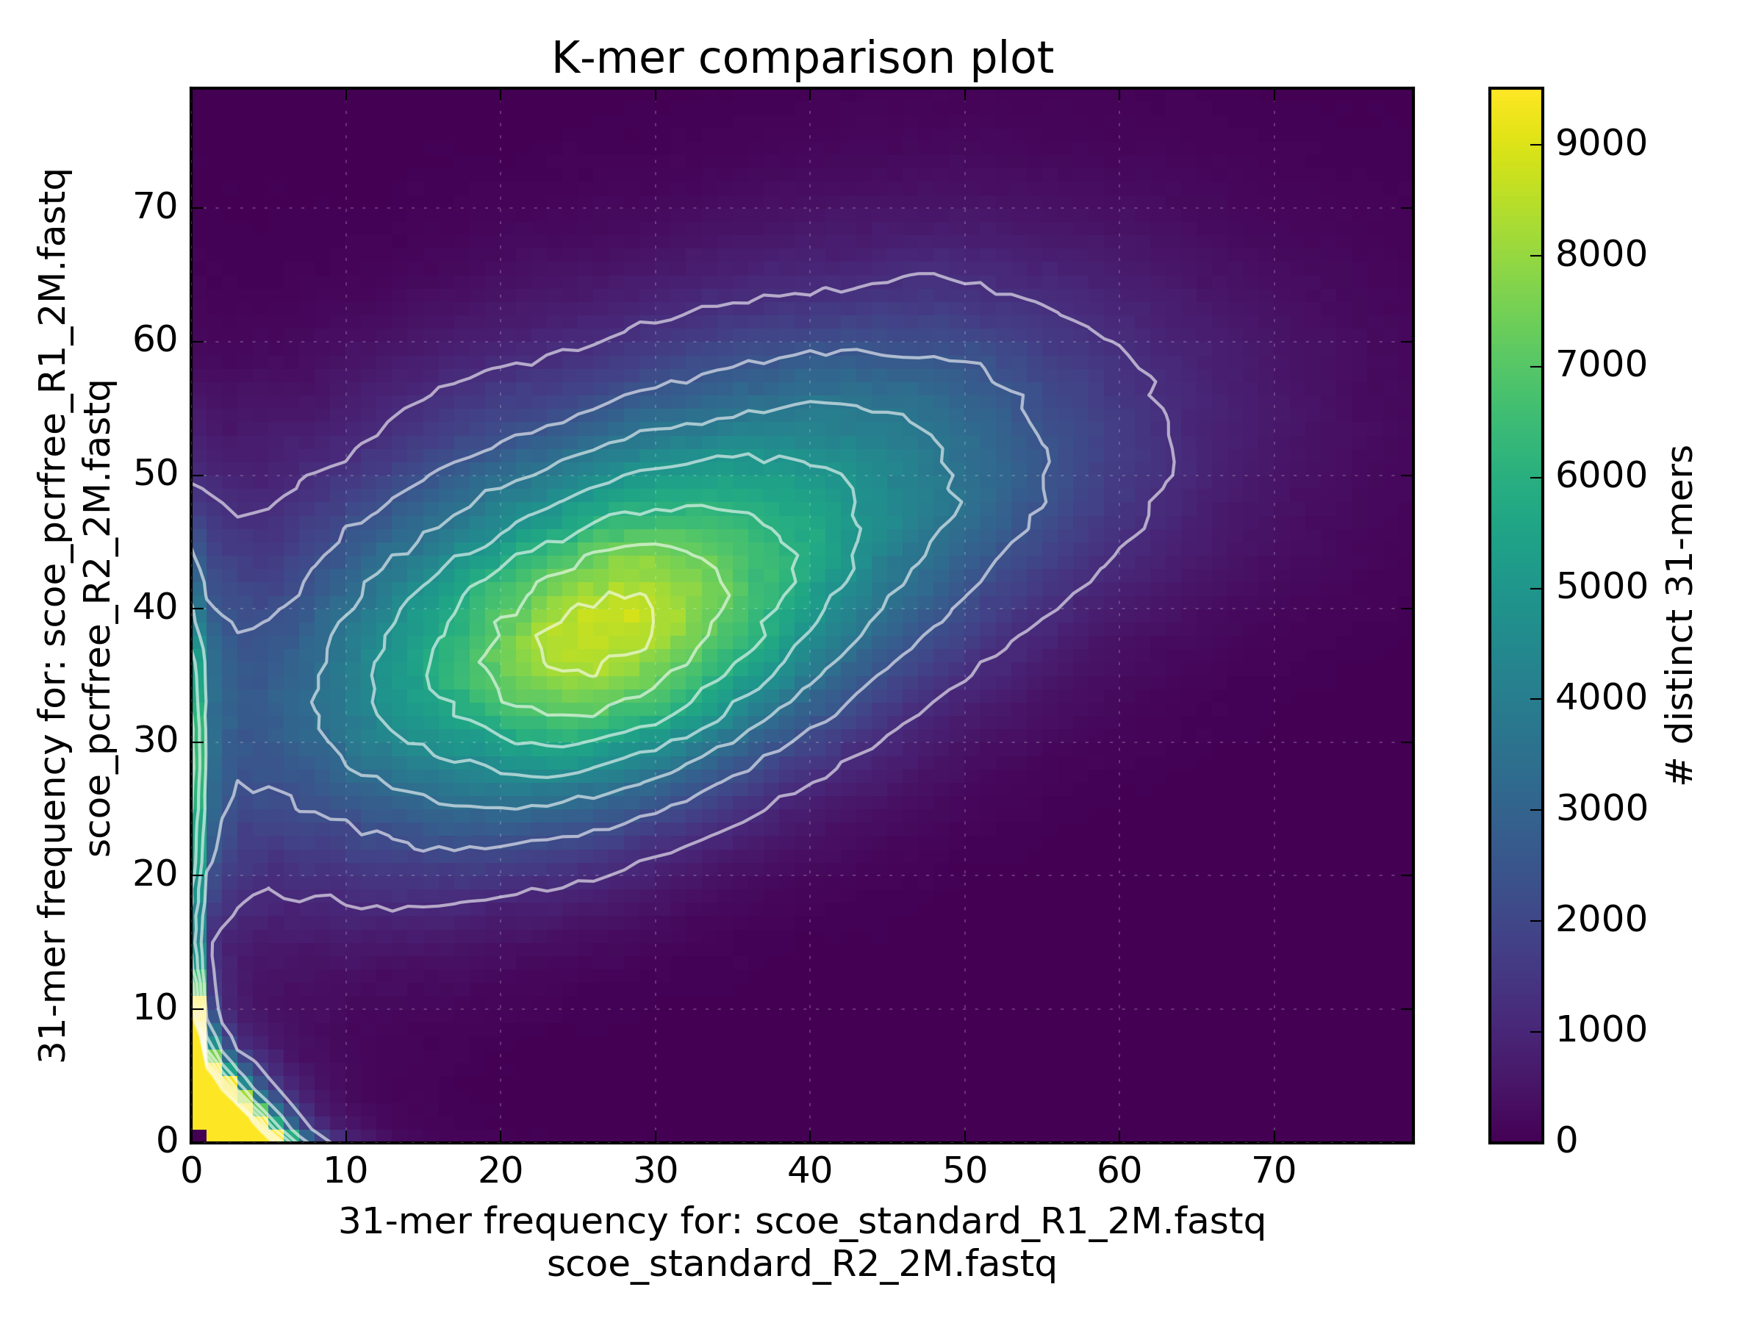
Data comparison
Standard vs PCR free
PCR free captures data missing in standard protocol
R1 vs R2

Slide 16
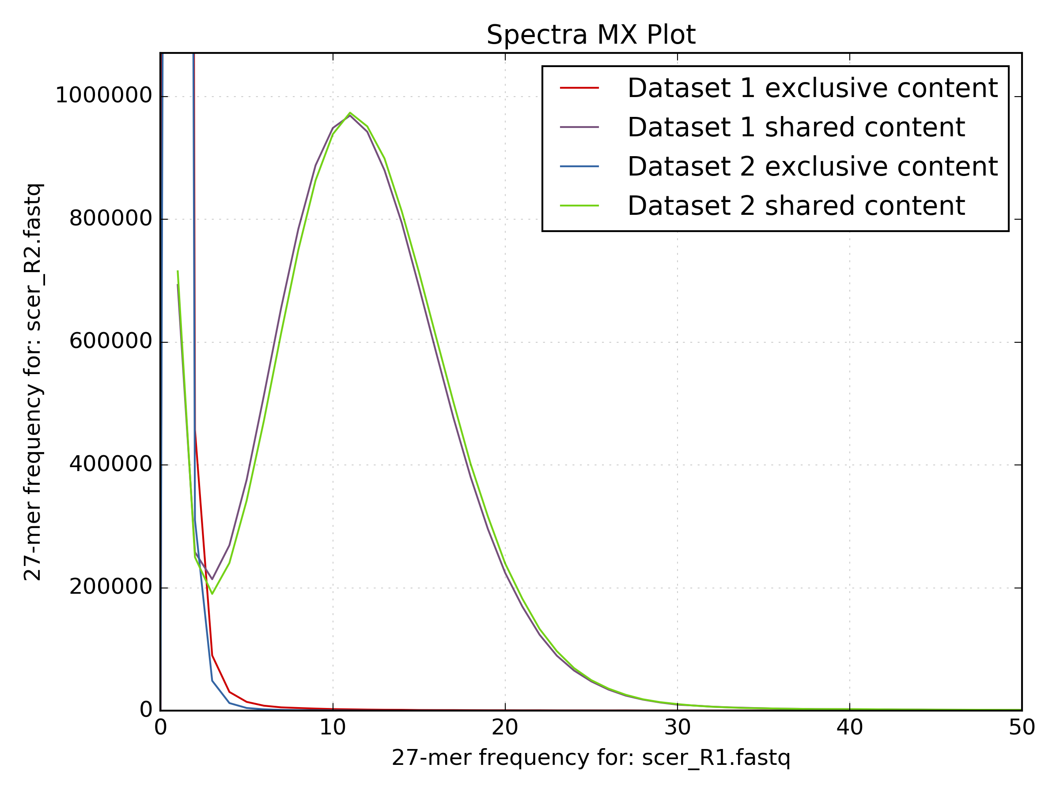
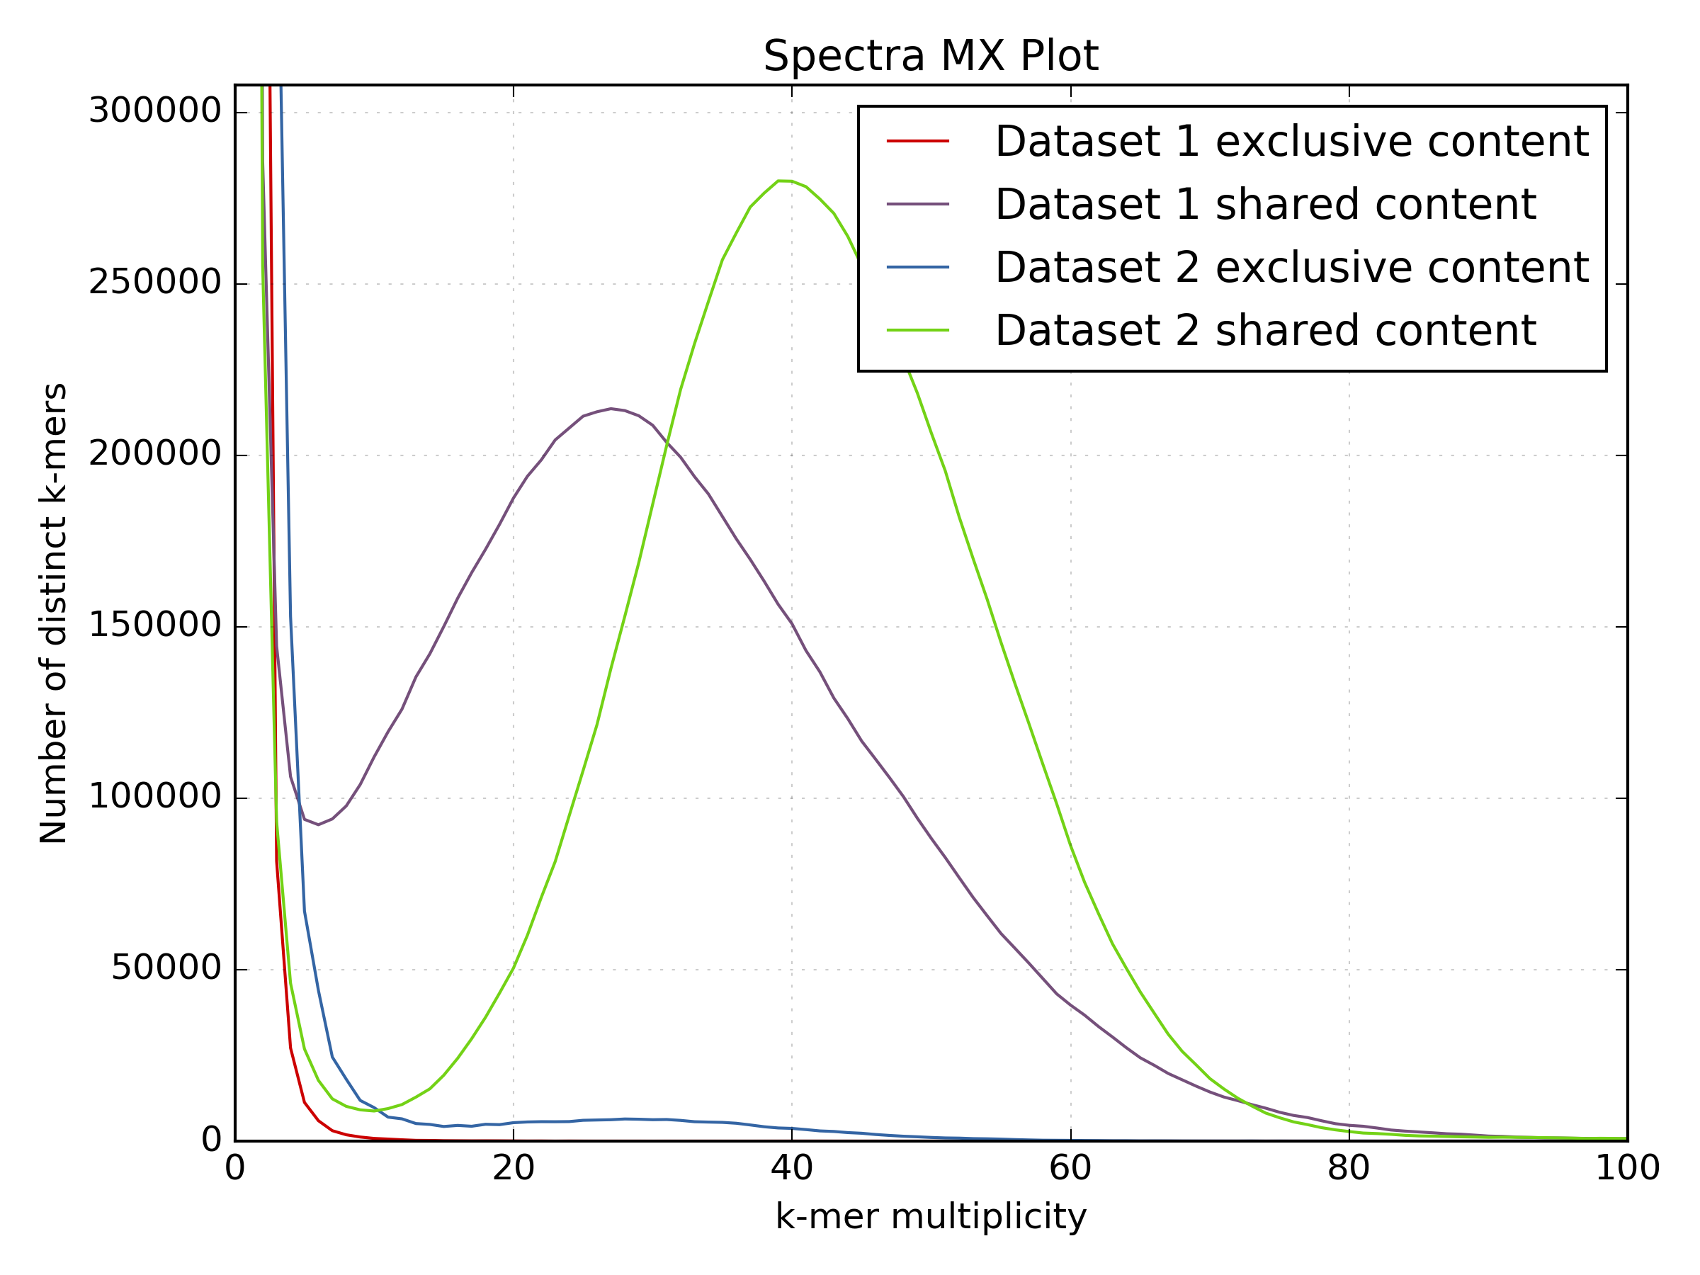
Data comparison
Low proportion of k-mers present only in dataset 2

Slide 17
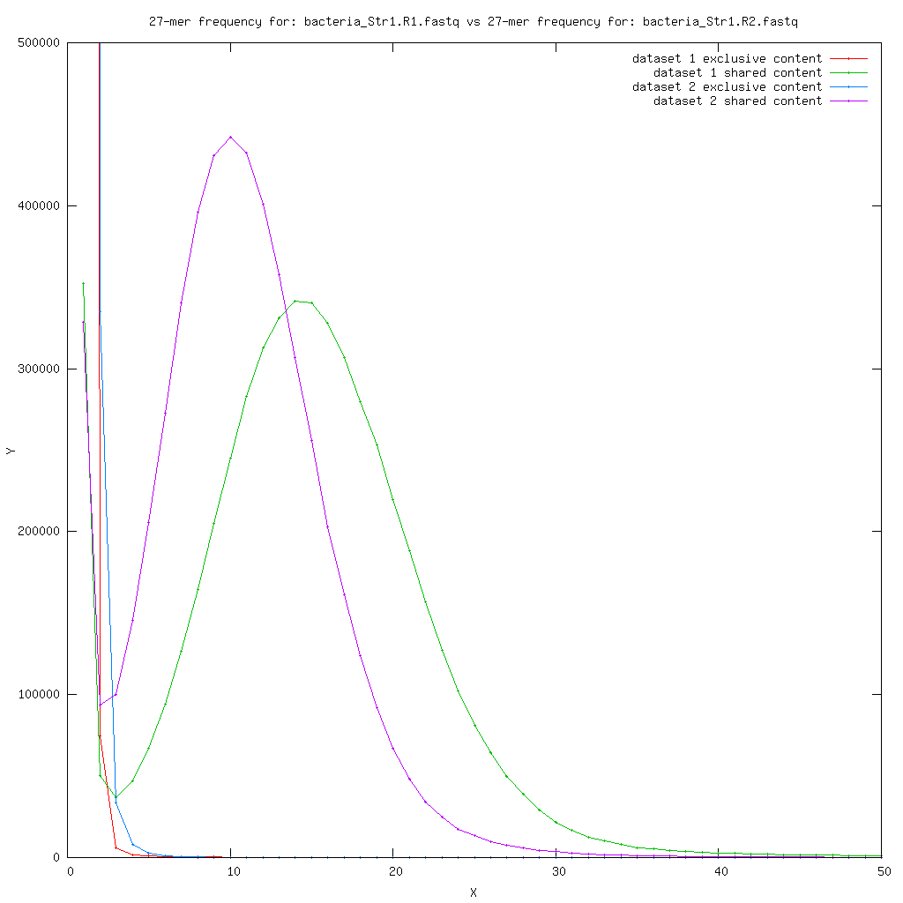
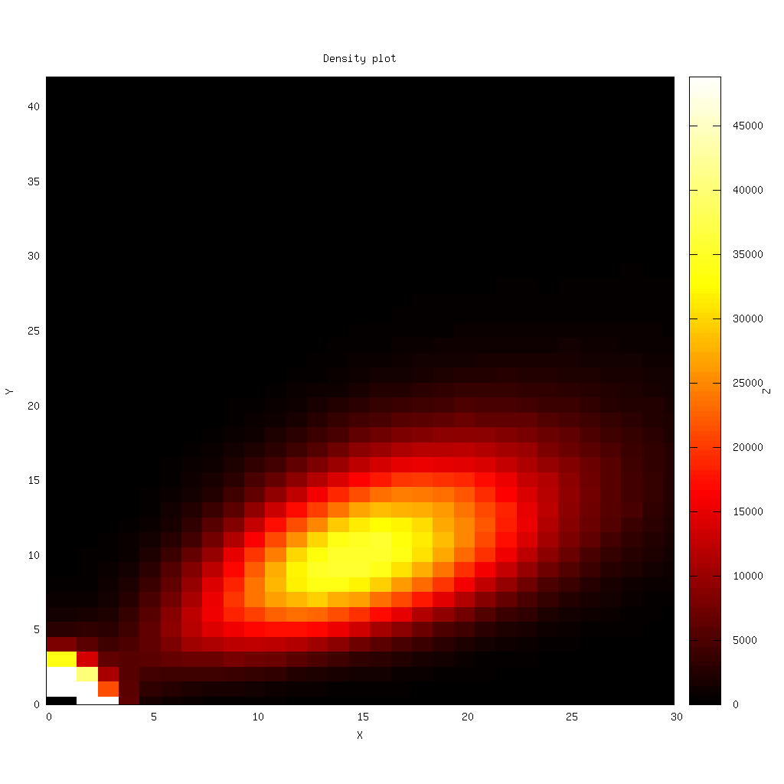
Data comparison
R1 v R2
Increased prevalence of
N’s in the sequence shift the distribution.
These k-mers have lower multiplicity and so increase the frequency of lower multiplicity k-mers. K-mers with N should not be counted
Lower quality dataset = More N’s in the sequence

Slide 18
Summary
Illumina
Md5sum
Format
Data Quantity
Quality Scores
GC Content
Nucleotide bias
Duplication
Adapter content
Genome complexity
Library bias
Contamination content
Fragment distribution
PacBio / Nanopore
Md5sum
Format
Data Quantity
GC Content
Adapter & Control check
Contamination content
Subread distribution

Slide 19
Information on sequence QC issues
Sequencing Fail https://sequencing.qcfail.com
SEQanswers http://seqanswers.com
BioStar https://www.biostars.org
Bioinformatics StackExchange https://bioinformatics.stackexchange.com

